Slide 1
Exploring Moral Language: A Validation of the Moral Foundations Dictionary
Kayla N. Jordan & Erin M. Buchanan
Missouri State University

Slide 2
Moral Foundations Theory (MFT)
Intuitions over rationality
Five moral foundations
Harm/Care
Fairness/Reciprocity
Ingroup/Loyalty
Authority/Respect
Purity/Sanctity
(Graham, Haidt, & Nosek, 2009; Graham, Nosek, & Haidt, 2012; Graham et al., 2011)

Slide 3
Political Orientation and MFT
Liberals
Rely on Harm/Care and Fairness/Reciprocity
Conservatives
Rely on all five moral foundations

Slide 4
Moral Foundations Questionnaire (MFQ)
30-items; two subscales (Graham et al., 2011)
Moral Relevance
1 (not at all relevant) to 6 (extremely relevant)
“Whether or not someone used violence (Harm)”,
“Whether or not someone was denied his or her rights (Fairness)”,
“Whether or not someone showed a lack of loyalty (Ingroup)”,
“Whether or not an action caused chaos or disorder (Authority)”,
“Whether or not someone did something disgusting (Purity)”.
Moral Judgments
1 (strongly disagree) to 6 (strongly agree)
“One of the worst things a person can do is hurt a defenseless animal (Harm)”,
“Justice is the most important requirement of a society (Fairness)”,
“I am proud of my country’s history (Ingroup)”,
“Men and women each have different roles to play in society (Authority)”,
“Chastity is an important and valuable virtue (Purity)”

Slide 5
Moral Foundations Dictionary (MFD)
Harm
Example words: safe, peace, protect, defend, war, kill, abuse, destroy, exploit
Fairness
Example words: equal, justice, rights, tolerant, bias, favoritism, exclusion
Ingroup
Example words: nation, family, patriot, unite, ally, foreign, enemy, treason, terrorism, immigrant
Authority
Example words: obey, law, tradition, hierarchy, control, rebel, dissent, insurgent, oppose, protest, riot
Purity
Example words: piety, clean, sacred*, holy, integrity, virtuous, innocent, sin, whore, taint, stain, tarnish, debase*, desecrate, wicked*, blemish, exploitative, pervert, wretched

Slide 6
Political Orientation and MFD
Liberal ministers used more harm, fairness, and ingroup words
Conservative ministers used more authority and purity words
(Graham, Haidt, & Nosek, 2009)
Abortion debate in Congress:
Republicans used more moral language overall
Republicans used more purity words
Democrats used more fairness words.
(Sagi & Dehghani, 2013)

Slide 7
Purpose & Hypotheses
The purpose of the current study is to validate the MFD as a measure of moral language.
Hypothesis 1 (construct validity):
Using multi-method, multi-trait (MTMM) analyses, the MFD should measure endorsement of moral foundations similarly to the MFQ.
Hypothesis 2 (predictive validity):
The MFD should predict political orientation in the same ways as the MFQ.

Slide 8
Study 1-Method Participants
290 undergraduate students
161 men; 129 women
80% Caucasian
Political orientation
M = 4.67, SD = 2.22
Scale: 1 (conservative) to 10 (liberal)
158 participants deleted

Slide 9
Study 1-Method Procedure
Primed with fictitious news stories about use of chemical weapons by Syrian government
Writing prompt
“Please write for five to ten minutes about your reaction to Syria's use of chemical weapons and United States' reaction.”
MFQ
Demographics
“Please rate your political orientation on a scale from 1 (conservative) to 10 (liberal)”

Slide 10
Study 2-Method Participants
162 undergraduate students
48 men; 114 women
89% Caucasian
Political orientation
M = 5.02, SD = 2.34
33 participants deleted

Slide 11
Study 2-Method Procedures
Randomly assigned to one of three writing prompts
Abortion
Same-sex marriage
Environmentalism
MFQ
Demographics
“Please rate your political orientation on a scale from 1 (conservative) to 10 (liberal)”

Slide 12
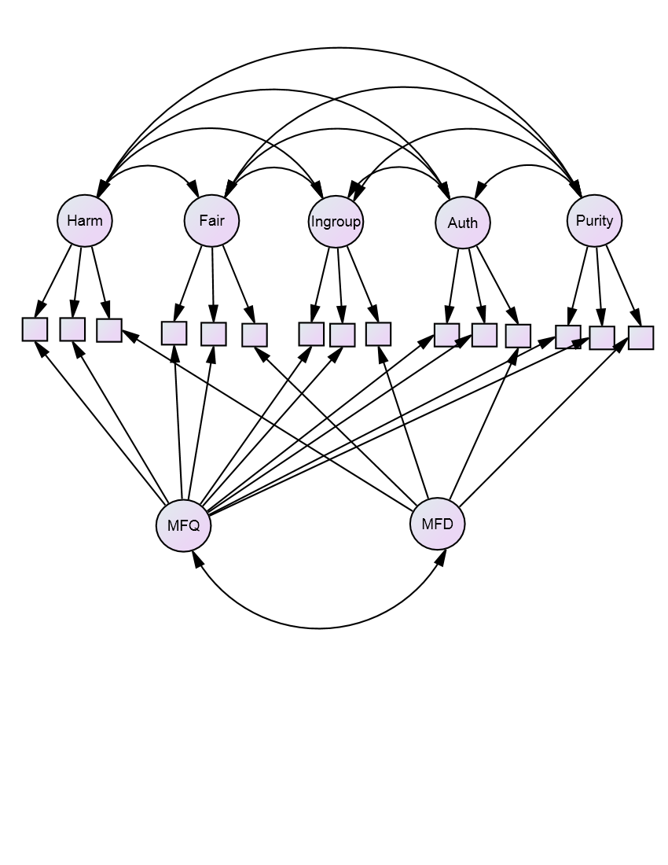
Results MTMM

Slide 13
Results MTMM
Model Comparisons
Model | χ² | df | CFI | RMSEA
Model 1 Correlated traits and methods | 903.577 | 512 | .875 | .054
Model 2 No traits, correlated methods | 2044.664 | 557 | .524 | .101
Model 3 Perfectly correlated traits, correlated methods | 1214.668 | 522 | .778 | .071
Model 4 Correlated traits, uncorrelated methods | 905.811 | 513 | .874 | .054

Slide 14
Results MTMM
Factor loadings of MFD
 | Factor Loadings |  |  | Bayesian Estimates
 | Estimate | S.E. | P | Mean | S.E.
HD<--Harm | -0.02 | 0.01 | 0.001 | -0.02 | 0.000
FD<--Fairness | -0.01 | 0.00 | 0.046 | -0.01 | 0.000
IGD<--Ingroup | 0.03 | 0.01 | *** | 0.03 | 0.000
AD<--Authority | 0.00 | 0.01 | 0.511 | 0.00 | 0.000
PD<--Purity | 0.00 | 0.00 | 0.231 | 0.00 | 0.000
HD<--MFD | 0.07 | 0.01 | *** | 0.07 | 0.001
FD<--MFD | 0.02 | 0.00 | *** | 0.02 | 0.000
IGD<--MFD | 0.05 | 0.01 | *** | 0.05 | 0.001
AD<--MFD | 0.00 | 0.01 | 0.417 | 0.00 | 0.000
PD<--MFD | 0.02 | 0.00 | *** | 0.02 | 0.000

Slide 15
Results Predicting Political Orientation
Regression coefficients for MFQ and MFD predicting political orientation
 |  | B | SE | 95% CI B |  | β | t | p | pr²
 |  |  |  | Lower | Upper
MFQ | Harm | 0.52 | 0.20 | 0.13 | 0.90 | 0.18 | 2.64 | 0.009 | 0.03
 | Fairness | 0.88 | 0.21 | 0.46 | 1.30 | 0.28 | 4.13 | <.001 | 0.06
 | Ingroup | -0.30 | 0.20 | -0.69 | 0.09 | -0.12 | -1.52 | 0.129 | 0.01
 | Authority | -0.44 | 0.22 | -0.87 | 0.00 | -0.15 | -1.97 | 0.05 | 0.02
 | Purity | -0.70 | 0.14 | -0.98 | -0.42 | -0.33 | -4.86 | <.001 | 0.08
MFD | Harm | 2.05 | 1.34 | -0.59 | 4.70 | 0.10 | 1.53 | 0.128 | 0.01
 | Fairness | -1.60 | 3.28 | -8.05 | 4.86 | -0.03 | -0.49 | 0.627 | <.01
 | Ingroup | -1.70 | 1.36 | -4.38 | 0.99 | -0.08 | -1.25 | 0.214 | 0.01
 | Authority | -1.68 | 2.26 | -6.13 | 2.77 | -0.05 | -0.74 | 0.458 | <.01
 | Purity | -5.21 | 3.14 | -11.39 | 0.97 | -0.11 | -1.66 | 0.098 | 0.01

Slide 16
Discussion
The Moral Foundations Dictionary does not seem to be a valid measure of moral foundations.
Problems with the MFD:
Low base rates of words
Out of 82,000 words, 1350 (2%) were MFD words.
Context
Reliability of MFQ

Slide 17
References
Federico, C. M., Weber, C. R., Ergun, D., & Hunt, C. (2013). Mapping the Connections between Politics and Morality: The Multiple Sociopolitical Orientations Involved in Moral Intuition. Political Psychology, 34(4), 589-610. doi: 10.1111/pops.12006
Graham, J., Haidt, J., & Nosek, B. A. (2009). Liberals and conservatives rely on different sets of moral foundations. J Pers Soc Psychol, 96(5), 1029-1046. doi: 10.1037/a0015141
Graham, J., Nosek, B. A., Haidt, J., Iyer, R., Koleva, S., & Ditto, P. H. (2011). Mapping the moral domain. J Pers Soc Psychol, 101(2), 366-385. doi: 10.1037/a0021847
Graham, J., Nosek, B. A., & Haidt, J. (2012). The moral stereotypes of liberals and conservatives: exaggeration of differences across the political spectrum. PLoS One, 7(12), e50092. doi: 10.1371/journal.pone.0050092
Sagi, E., & Dehghani, M. (2013). Measuring moral rhetoric in text. Social Science Computer Review, 32(2), 132-144.
Weber, C. R., & Federico, C. M. (2013). Moral Foundations and Heterogeneity in Ideological Preferences. Political Psychology, 34(1), 107-126. doi: 10.1111/j.1467-9221.2012.00922.x
Contact: Kayla Jordan (kaylajordan91@gmail.com)

